Slide 1
Azure Data Lake

Slide 2
Intro to Data Lake
Data in its purest form
Data lake is a repository of information in its raw form which can be used for multiple purposes
Capture the value of big data
Incorporating 4 V’s of data – Volume, Velocity, Variety and Veracity

Slide 3
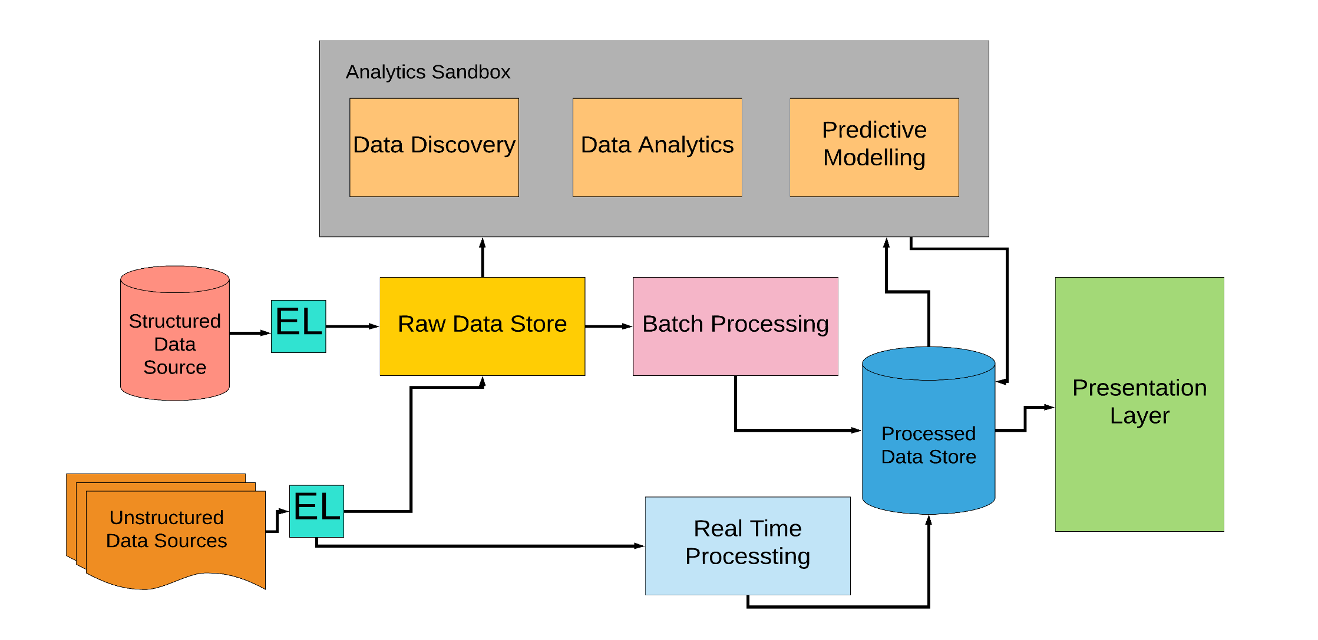
Data Lake Architecture

Slide 4
Components of Data Lake Architecture
Lambda architecture
  Batch processing layer
  Speed layer that processes data in real-time
Analytical Sandbox
  Data discovery for data scientists
  Rapid prototyping and extract data value
Cataloging and Governance
  Cataloging is most important aspect in data science field
  Data cataloging helps analysts and data scientists to decide which data point they can use for data analysis

Slide 5
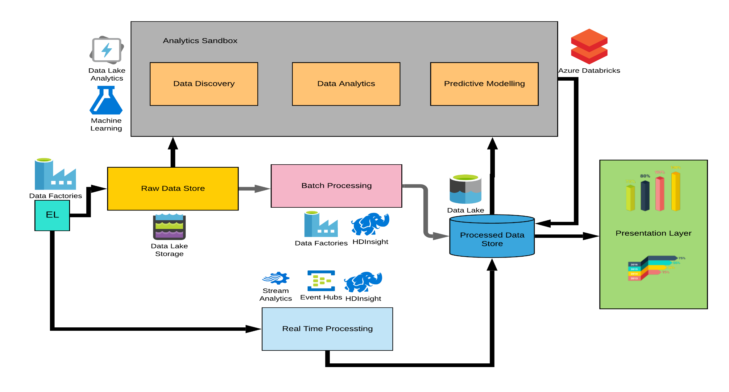
Data Lake Architecture to Azure Services

Slide 6
Key Features
Hadoop Compatible Access
  Allows to manage data as it is done with HDFS (Hadoop Distributed File System)
  ABFS(Azure Blob File System) is available across within all Apache Hadoop environments which helps to access data from Data lake
Superset of POSIX permissions
  Supports both ACL and POSIX permissions along with some extra granularity
  Settings may be configured through Storage Explorer or through frameworks like Hive and Spark
Optimized driver
  The ABFS is optimized specifically for big data analytics
  The corresponding REST APIs are surfaced through the endpoint dfs.core.windows.net

Slide 7
Azure Blob File System Driver (ABFS) - 1
This driver helps many applications and frameworks to help access Azure data lake without any code explicitly referring to Azure Data Lake
The rest interface of Azure Data Lake Storage API is designed to support file system semantics over Blob storage.
Link to Azure Data Lake Storage API:
https://docs.microsoft.com/en-us/rest/api/storageservices/data-lake-storage-gen2
URI scheme to reference data
  Data lake has it’s own URI scheme through which it can access the resource and it is consistent with other File system implementations of Hadoop File Systems
  Structure of URI: abfs[s]://file_system@account_name.dfs.core.windows.net/<path>/<path>/<file_name>

Slide 8
Azure Blob File System Driver (ABFS) - 2
  Internally, ABFS diver translates the URI to files and directories
Authentication – There are two types of authentication supported by ABFS driver
  Shared Key: Permits to access all resources within the account. The key can be stored in Hadoop configuration
  AAD OAuth Bearer Token: Uses identity of end user or configured service principle
Configuration – All configuration is stored in store-site.xml of Hadoop configuration

Slide 9
Hierarchical Namespace
Allows Azure Data lake storage to provide file system performance
Hierarchical namespaces allows files/objects within the storage account to be organized into file system with hierarchy of directories and sub-directories
Provides scalability and cost-effectiveness of object storage since the file system semantics are very familiar with Analytics engine
The benefits of hierarchical namespaces include
  Atomic directory manipulation
  Familiar interface style

Slide 10
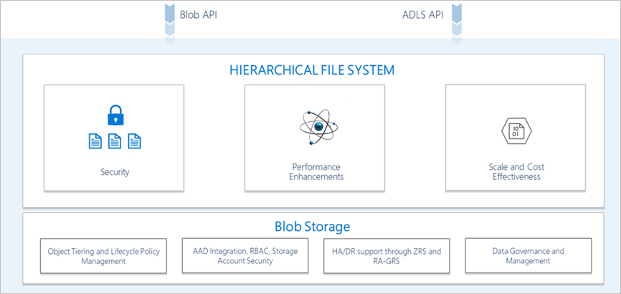
Multi protocol Access
With multi-protocol access, you can work with your data using ecosystem of tools, applications and services since data lake storage supports hierarchical namespaces and use them without even modifying it

Slide 11
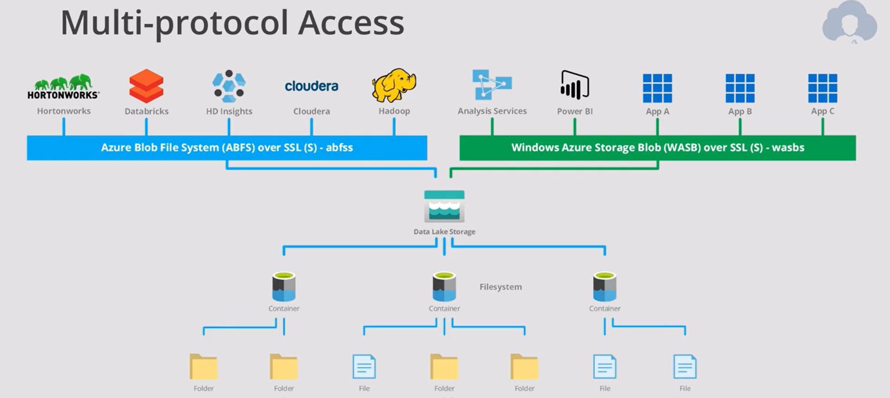
Multi protocol Access (Contd….)

Slide 12
Tools to work with data
Windows Powershell
Azure CLI
Storage Explorer
AzCopy tool
Azure Data Factory
DistCp
Azure Portal Egress
Apache Storm on HDInsight

Slide 13
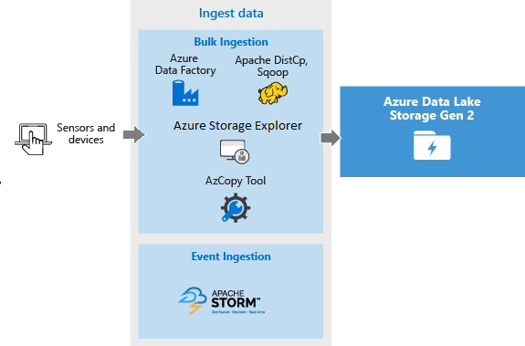
Azure Data Lake for Big Data – Ingest Data 1

Slide 14
Azure Data Lake for Big Data – Ingest Data 2
There are different types of data that can be ingested into Data lake depending on the requirement. Following are the types
Ad hoc data – Smaller data sets for prototyping big data application.
Streamed data – Data that is captured through various sources such as applications, devices, IOT interfaces, etc.
Relational data – Relational data has huge data that can be analyzed when process through big data pipeline
Web server logs – This is a common use case for big data applications that requires large data to be uploaded

Slide 15
Azure Data Lake for Big Data – Ingest Data 3
HD Insights Cluster - Insights clusters access data from Azure blob storage data. In order to gain better performance, data can be copied to Azure data lake
Really Large Datasets - For large datasets use azure Express route which connects on premises data with Azure cloud so that transfer of the data becomes inexpensive and fast

Slide 16
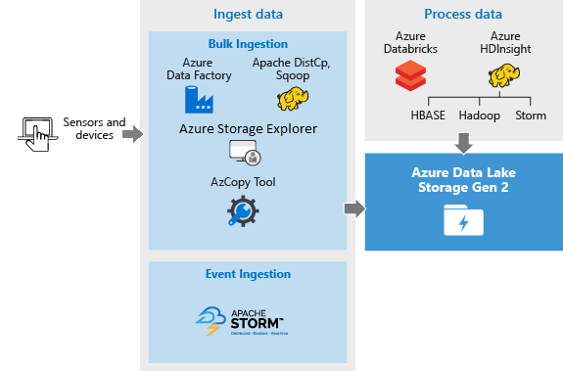
Azure Data Lake for Big Data – Process Data 1

Slide 17
Azure Data Lake for Big Data – Process Data 2
Analysis can be run on azure data lake storage using supported big data applications
Following are some of the ways
  Use data lake storage with Azure HDInsight clusters
  Using Data bricks
    Analyze data using Azure data bricks
    Extract, transform and load using Azure data bricks
We will discuss the solution based on Azure data bricks

Slide 18
Azure Data Lake for Big Data – Visualize Data
Power BI connector can be used to visualize data that is stored on data lake.
We will discuss this solution in this session

